Slide 1
Water Management and Soil Nutrient monitoring using Arduino and NodeMcu
By:
Three’s Company Team
Mahatma Gandhi Institute of Technology
Department of ECE
Presented By:
Nihanth V
Kishore M
Vivekananda A

Slide 2
Preface
Water resources have been historically regarded as essential for a good agricultural output and adequate food supply for the people. All ancient civilizations that have prospered developed successful water resources management schemes. Water resources for agriculture and food production are classified as either surface or underground water. In humid climates surface water is the main source for irrigation systems. Under sub-humid and arid conditions, underground water is the major water resource for agriculture and food production.
According with the Food and Agriculture Organization of the United Nations, FAO (1998), demands for water for growing more food will increase causing shortages in regions that up to know are self sufficient in water resources. The growth in shortage could be avoided only by developing the potential sources or by decreasing the withdrawals and simultaneously increasing water use efficiency.

Slide 3
Abstract
Creating nourishment economically for an ever-increasing populace is one of the most noteworthy single challenges of our time, while too adjusting the issues of climate alter, utilize of rare water and natural security. Precision farming can move forward both abdicate and benefits by utilizing less assets, whereas at the same time making agribusiness more maintainable and less contaminating. Any agriculturist with any estimate of arrive can embrace this technology-based approach. Sensor-based estimations gives more information, such as moisture levels, fertilizer viability, and plant response to varied variables, such as temperature and light. Farmers can use these sensor estimates to help them make decisions. The comes about gotten by receiving these strategies can be a boon for agriculturists and holds awesome potential for making agriculture more economical and expanding nourishment accessibility. Precision farming can address both financial and natural issues that encompass generation farming in today’s world.

Slide 4
Aim
To develop a system to monitor and manage the rate of water, soil fertility, crop growth, pest & diseases, macro & micro-nutrients, etc.
The technology can help improve the efficiency of water usage in agriculture and finds application in open farms, greenhouses, gardening, and research and agricultural labs. It can help with guidance about ways to optimize water usage as per the requirement of crops and soil.

Slide 5
Components required
Arduino Uno
Motor control relay
DC Submergible water pump
LDR sensor
Temperature And Humidity Sensor (DHT11)
Moisture sensor
Node MCU (ESP-8266)

Slide 6
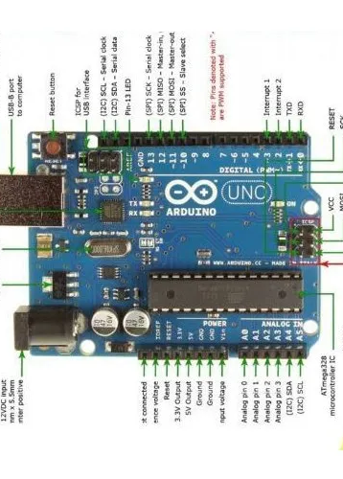
Arduino Uno
Arduino UNO is a microcontroller board based on the ATmega328P. It has 14 digital input/output pins (of which 6 can be used as PWM outputs), 6 analog inputs, a 16 MHz ceramic resonator, a USB connection, a power jack, an ICSP header and a reset button.
It contains everything needed to support the microcontroller; simply connect it to a computer with a USB cable or power it with a AC-to-DC adapter or battery to get started.

Slide 7

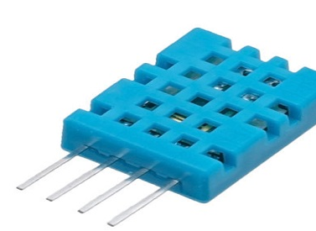
DHT11 Sensor
The DHT11 is a basic, ultra low-cost digital temperature and humidity sensor.
It uses a capacitive humidity sensor and a thermistor to measure the surrounding air and spits out a digital signal on the data pin (no analog input pins needed).
You can get new data from it once every 2 seconds, so when using the library from Adafruit, sensor readings can be up to 2 seconds old.

Slide 8
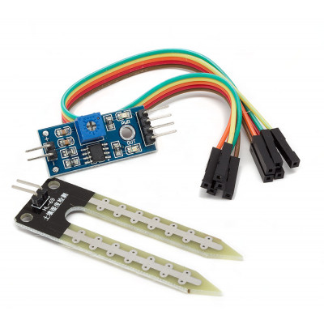
Soil Moisture Sensor
A typical YL-69 Soil Moisture Sensor is made up of two parts. A two-legged lead that is placed in the soil or anywhere water content can be measured.
The Soil Moisture Sensor measures soil moisture in response to changes in the earth's electrical conductivity . The electrical resistance of the sensor is measured between its two electrodes.
The electrical resistance of the sensor is measured between its two electrodes. Soil moisture sensors can provide instantaneous information about soil moisture status within the root zone and thus aid in the timely application of water.

Slide 9
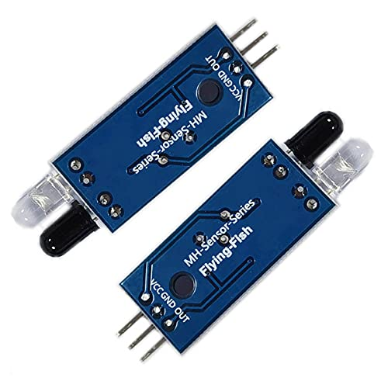
LDR Sensor
An LDR or light dependent resistor is also known as photo resistor , photocell, photoconductor.
It is a one type of resistor whose resistance varies depending on the amount of light falling on its surface. When the light falls on the resistor, then the resistance changes.
These resistors are often used in many circuits where it is required to sense the presence of light.
Hence, we can utilize the light sensor circuit for automatic switch OFF the loads based on daylight’s intensity by employing a light sensor.
Useful for large scale industries.

Slide 10
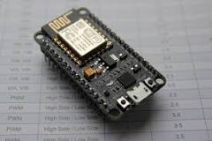
NodeMcu –ESP-8266
NodeMCU is a low-cost open source IoT platform.^{[4][5]} It initially included firmware which runs on the ESP8266 Wi-Fi SoC from Espressif Systems, and hardware which was based on the ESP-12 module. Later, support for the ESP32 32-bit MCU was added.
. The name "NodeMCU" combines "node" and "MCU" (micro-controller unit). Strictly speaking, the term "NodeMCU" refers to the firmware rather than the associated development kits..

Slide 11
Schematic diagram
DHT – 11 Sensor
DC motor pump
LDR sensor
Arduino Uno
Motor relay
If moisture level is low water pump is switched ON
NodeMCU
Moisture sensor

Slide 12
Project Overview
We can dip the soil moisture(resistive) sensor into the required testing soil to monitor the moisture content in the given soil.
DHT11 Sensor measures the surrounding temperature and humidity through which we can easily visualise the necessary conditions for the growth of the given specimen.
Water flow rate can be measured by the water flow sensor YF-S201 that is rate and volume of water flowing.
Water can be pumped by the Mini DC Submergible Pump to the soil so that we can know the rate of flow of water.
Motor Control Relay can be used to control the flow of water.
The output can be verified by HC05 Bluetooth Module which can connect the wholesome output to mobile (or) any device.

Slide 13
Importance of Water Use Efficiency
Water-use efficiency (WUE) shows a relationship between plant productivity and water use. It is the amount of biomass produced per unit mass of water used by the plant.
Increase in water-use efficiency are commonly cited as a response mechanism of plants to moderate to severe soil water deficits and have been the focus of many programs that seek to increase crop tolerance to drought. However, there is some question as to the benefit of increased water-use efficiency of plants in agricultural systems, as the processes of increased yield production and decreased water loss due to transpiration (that is, the main driver of increases in water-use efficiency) are fundamentally opposed . If there existed a situation where water deficit induced lower transpirational rates without simultaneously decreasing photosynthetic rates and biomass production, then water-use efficiency would be both greatly improved and the desired trait in crop production.

Slide 14
THANK YOU !

